Slide 1

KidSafe Ride: School Transport Tracker
By ADITYA SUNIL CHOUKSEY

Slide 2

Problem Statement
Safety Concerns: Parents and educational institutions face significant anxiety regarding children's safety during school bus journeys.
Lack of Visibility: There is a complete lack of real-time visibility into current bus locations and estimated arrival times.
Inefficient Communication: Traditional methods rely on manual phone calls to drivers or school staff, which are often unreliable and lead to miscommunication.
Local Context: Rapidly growing areas like Kharghar and Belapur in Navi Mumbai face increasing traffic congestion, making accurate tracking essential.

Slide 3
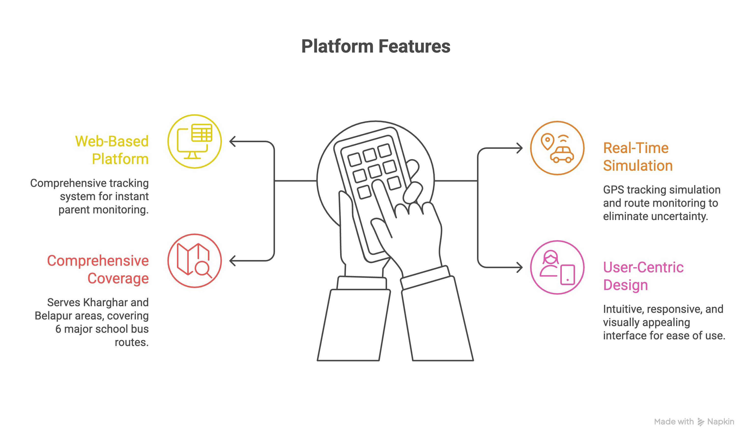
2. Solution

Slide 4
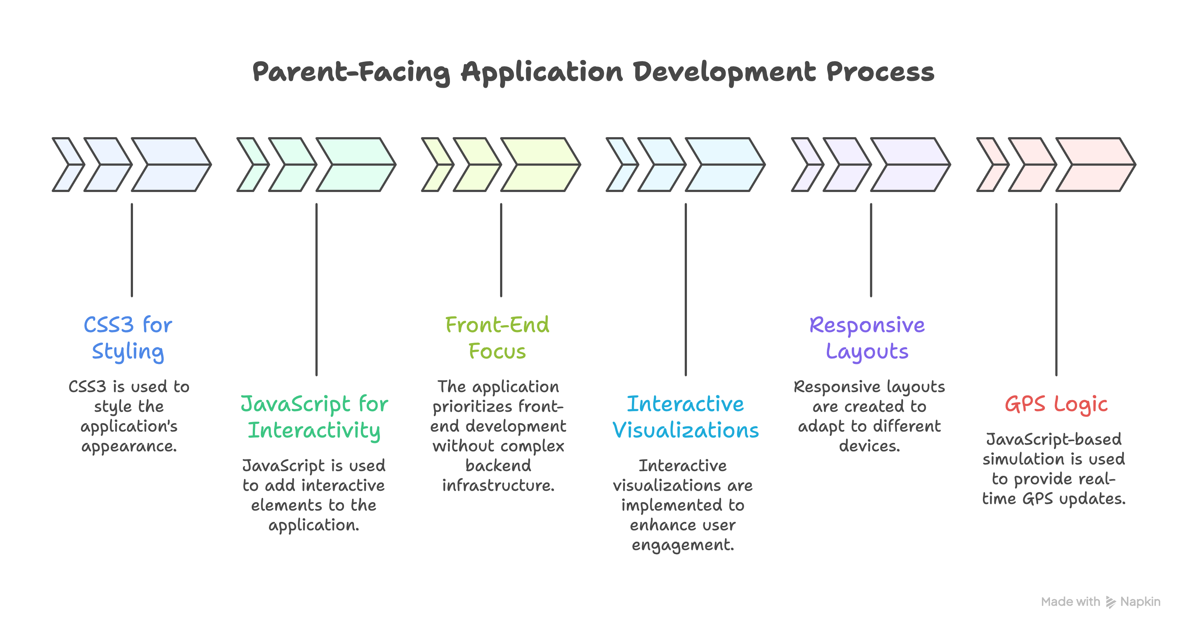
3. Working

Slide 5
4. Conclusion
Reduced Anxiety: The system successfully addresses parental stress by providing reliable, real-time data.
Operational Efficiency: Replaces inefficient manual communication with automated tracking and accurate ETAs.
Scalability: Proves that standard web technologies can effectively solve real-world transportation and safety challenges.
Future Impact: Sets a foundation for integrating actual GPS hardware and expanding to more residential zones in Navi Mumbai.

Slide 6
Thank You
By Aditya Sunil Chouksey
SAM ALTMAN
150096725070

